Slide 1
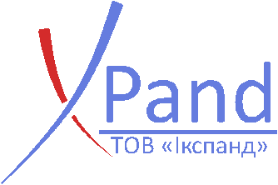
XPand a biotech company
The Power of Science to Improve Life

Slide 2
Our MISSION
To become
a No. 1 choice for regenerative biomaterials

Slide 3
TAVI XPAND
Transapical Transcatheter Aortic Valve
Implantation System

Slide 4
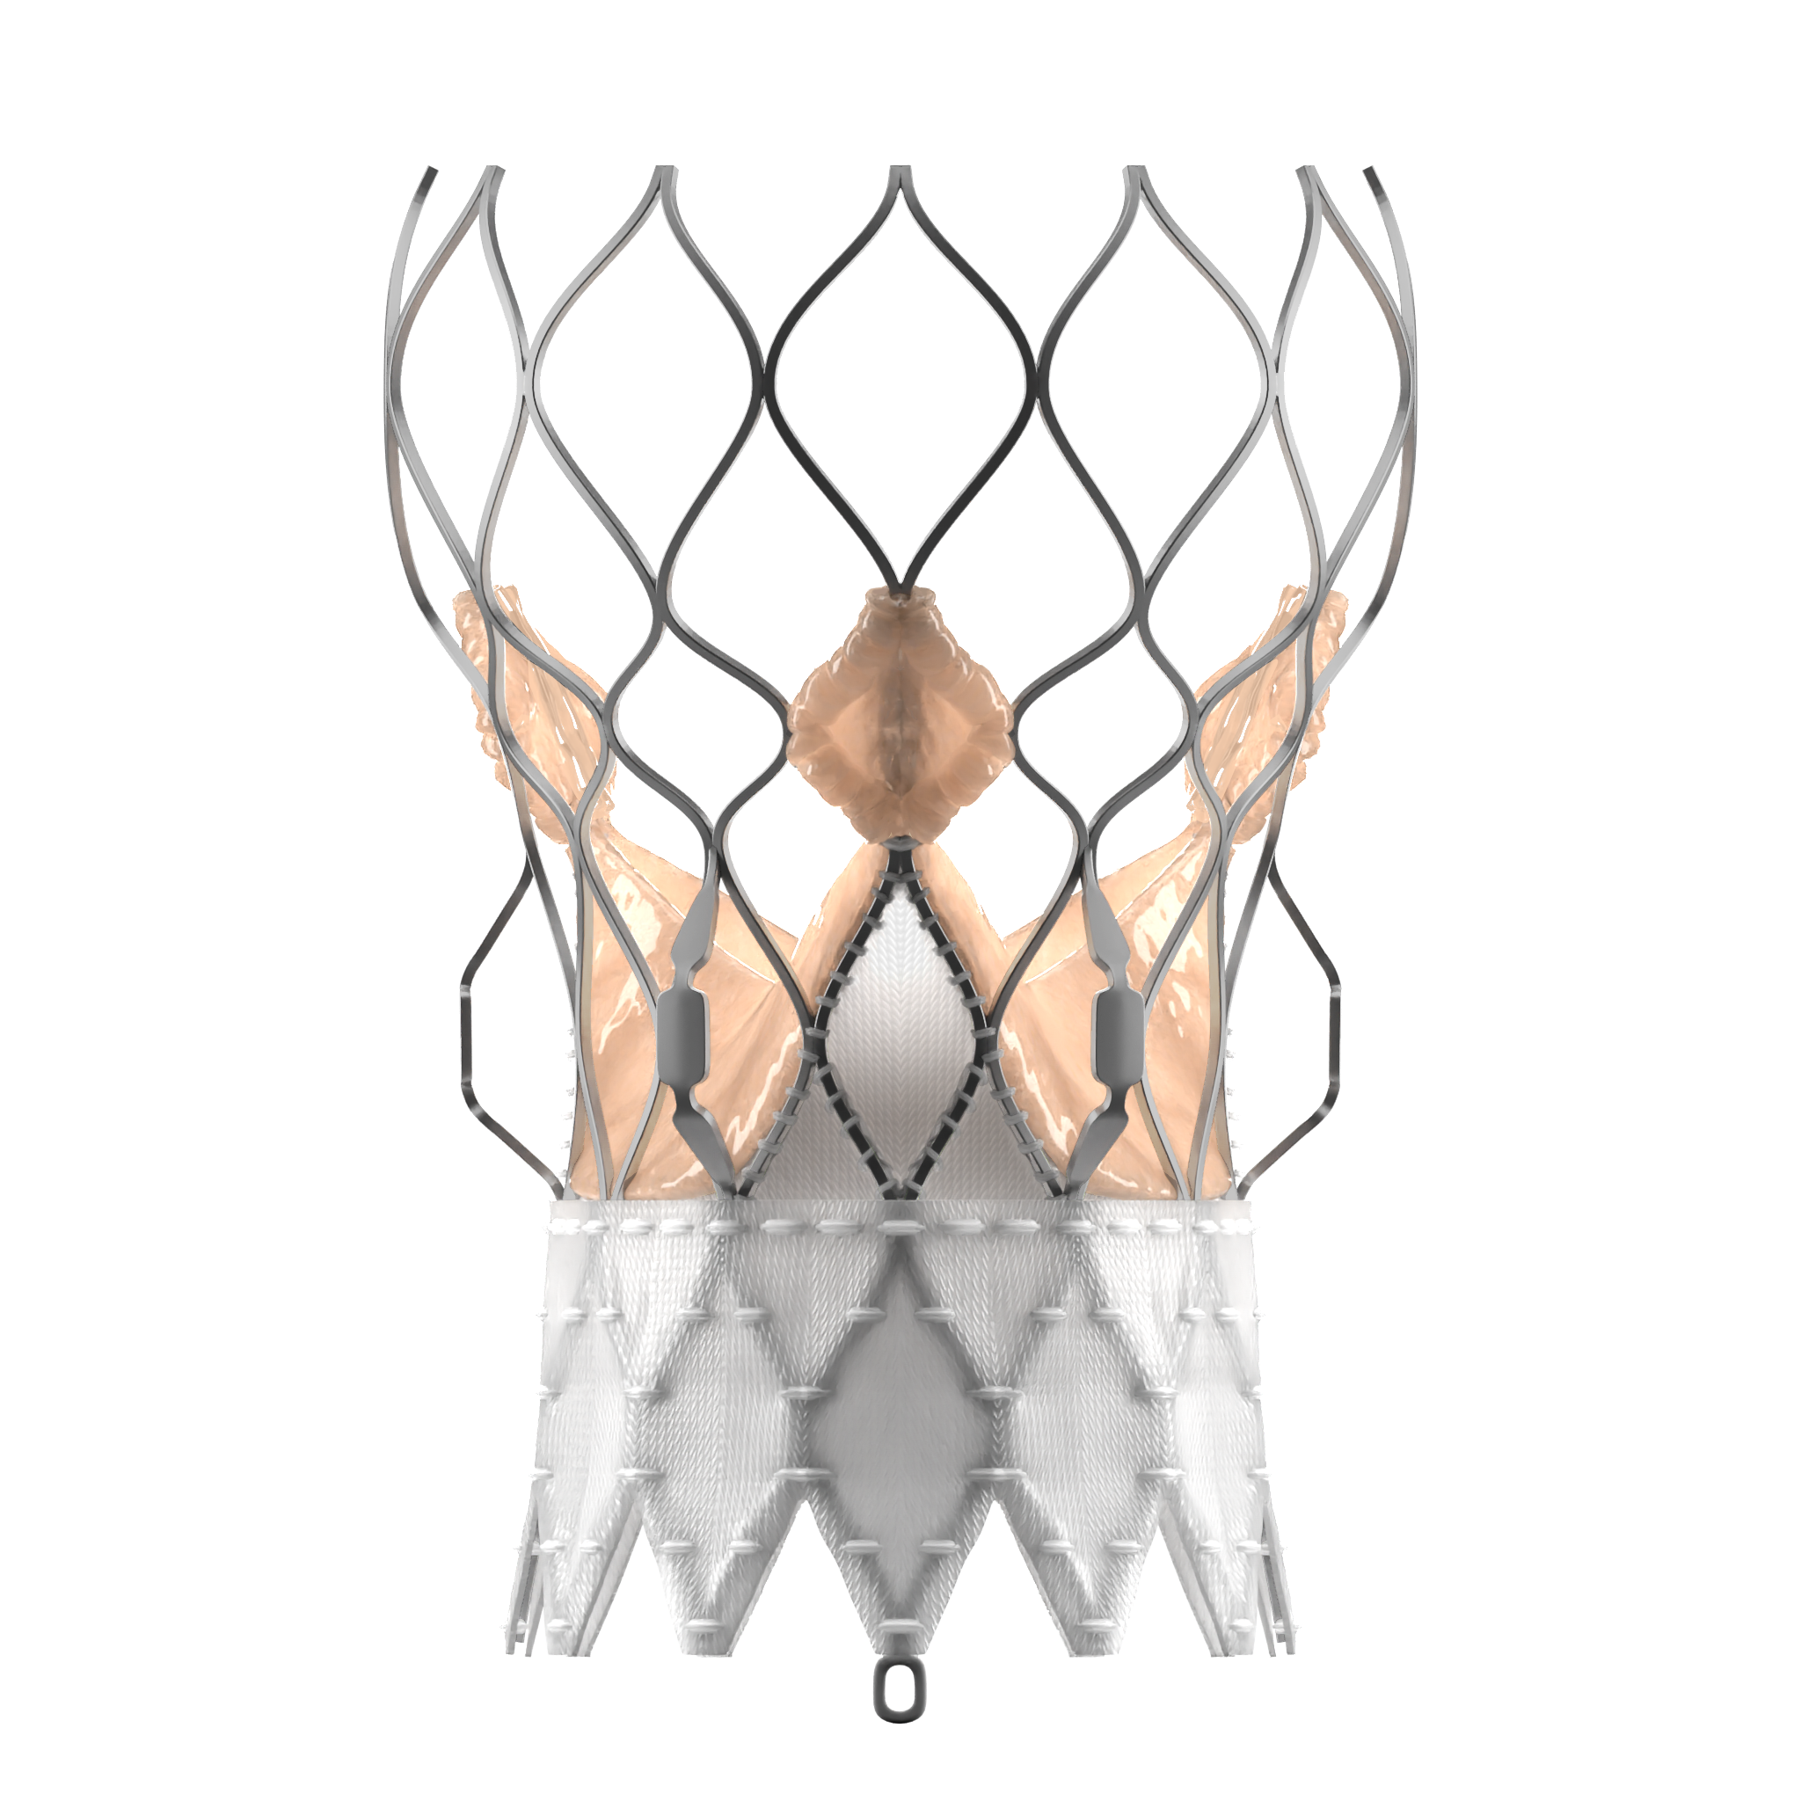

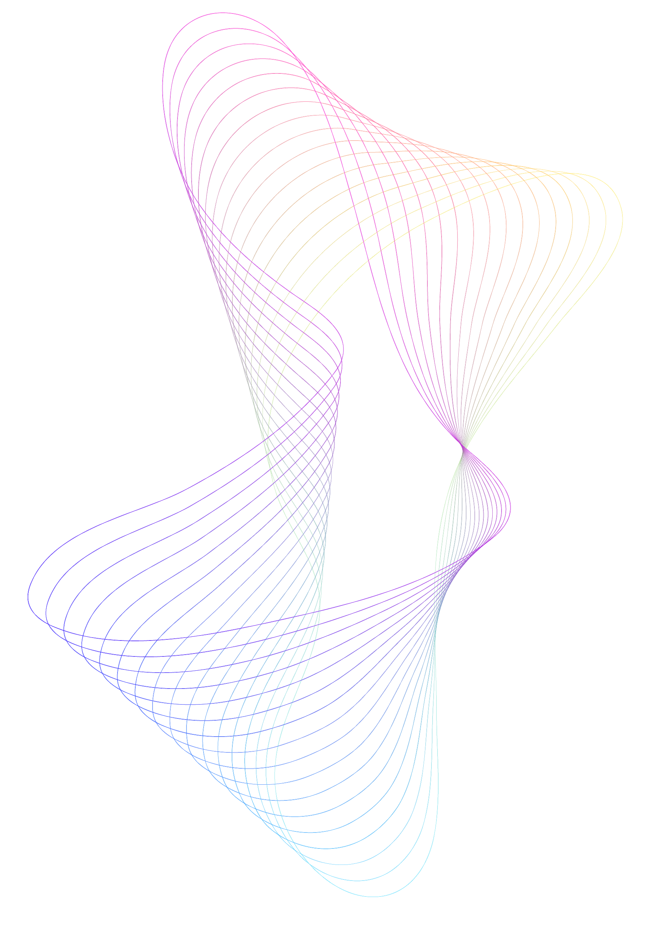
TAVI XPAND – a transapical transcatheter aortic valve implantation system
The result of a
9 years’ experience in the development and research dedicated to transcatheter aortic valve implantation
An innovative and reliable transapical transcatheter aortic valve implantation system created jointly with German and French scientists

Slide 5
What is TAVI
(or TAVR)?
TAVI or TAVR stands for transcatheter aortic valve implantation or replacement.
This is a minimally invasive procedure that allows inserting a new valve without removing the old, diseased valve. The new valve is placed inside the old valve which is unable to function properly and in many cases requires replacement.
The collapsible new valve is delivered through a catheter (a thin wire or tube) – such an approach is somewhat similar to placing a stent in the artery. Once the new valve is delivered to the implantation site, it expands and pushes the old valve leaflets out. The new valve then takes over the job of regulating the blood flow.

Slide 6
What is involved in the procedure?
01
02
Valve replacement usually requires open-heart surgery, in which the chest is surgically separated. Alternatively, the TAVR (or TAVI) procedure can be done through very small openings making the procedure less invasive.
Patients usually need less time for postoperative recovery after the TAVI procedure compared to valve replacement when using open-heart surgery.
03
The TAVI procedure can be performed using several protocols/techniques, allowing the interventional cardiac surgeon to choose the one that would provide the best and safest way to access the valve:
transapical approach
This is a minimally invasive surgical procedure by making a small incision in the chest and inserting the valve through the tip (the apex) of the left ventricle.
◎
While TAVI is not without certain risks, it allows surgical treatment options to people who are not considered candidates for valve replacement using open-heart surgery for a variety of reasons.
04

Slide 7
Who will benefit from TAVI?
The TAVI procedure has demonstrated to be rather effective in patients with symptomatic severe aortic stenosis in all risk categories (low, moderate or high) for valve replacement using standard open-heart surgery.
TAVI can be an effective option to improve the quality of life in patients who otherwise have limited choices for aortic valve repair.

Slide 8
What are the benefit and advantages of TAVI?
The advantages of TAVI, just like any other minimally invasive surgery, may include the following advantages:
No need to stop
the heart or use cardiopulmonary
bypass for
the procedure
Shorter
hospital
stay
Quicker time
of postoperative
recovery
Minimal risk of
infection
Minimal injury
to the chest and
the heart muscle
Ability to resume daily activities and get back to your normal life faster

Slide 9
XPAND
provides cardiac surgeons
with reliable solutions
that work for the most complicated cases!

Slide 10
TAVI XPAND™ Transapical Transcatheter Aortic Valve Prosthesis
Ergonomic Design
The TAVI XPAND valve consists of an external Dacron cuff that supports the platform configuration.
These characteristics provide the following benefits of the sealing mechanism:
◎
The external cuff increases the surface area contact between the new and the native valve providing advanced sealing
Small frame size and cell geometry provide consistent radial force across the treatable annulus range
Stability “auricles” are available to ensure secure attachment of the prosthesis
◎
◎

Slide 11
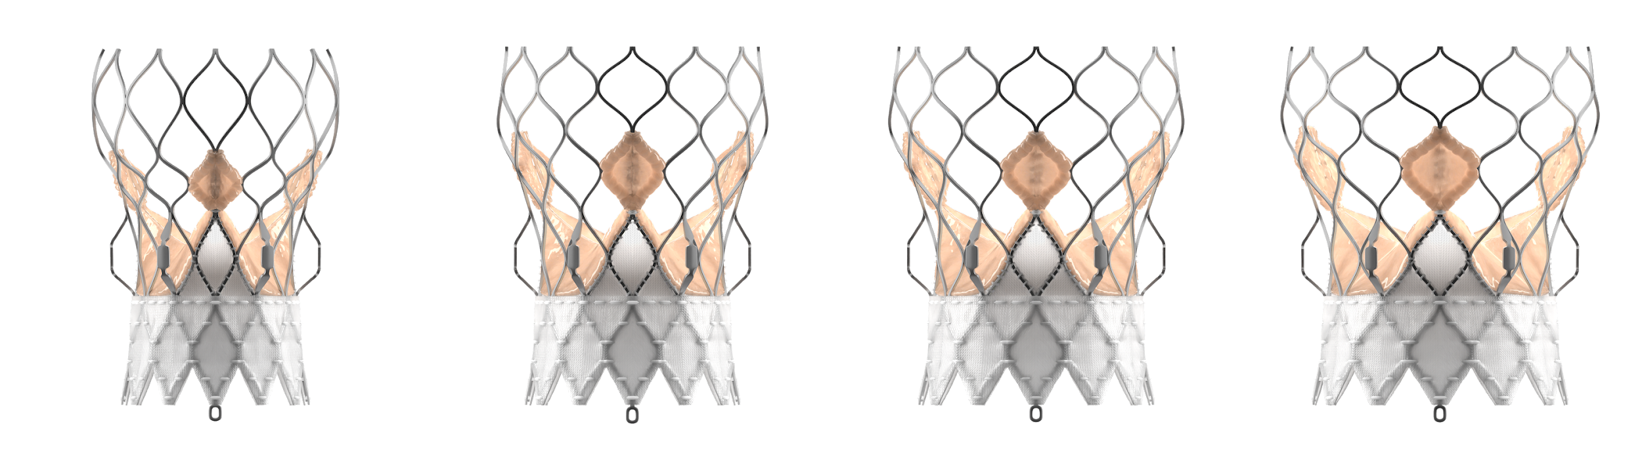
TAVI XPAND™ Transapical Transcatheter Aortic Valve Prosthesis
ERGONOMIC DESIGN
23 mm
31 mm
23 mm valve
26 mm valve
29 mm valve
31 mm valve

Slide 12
TAVI XPAND™. Technical Characteristics
leaflets
◎
Bovine pericardium
cuff
◎
DACRON
◎
stent
Self-expanding nitinol
◎
sterilization
Chemical
Storage solution
◎
Formaldehyde (0.5%)
Storage temperature
◎
5 ℃ – 25 ℃
Shelf life
◎
6 months

Slide 13
TAVI XPAND™. Technical Characteristics
Parameters | XPD026 | XPD027 | XPD028 | ISO 5840-3:2013 minimum requirements
EOA (cm²) | 2.13 ± 0.01 | 2.21 ± 0.01 | 2.17 ± 0.01 | ≥ 1.25
Transvalvular regurgitant fraction (% of forward flow volume) | 2.38 ± 0.24 | 2.60 ± 0.37 | 2.71 ± 0.31 | ≤ 10
Closure volume (% of forward flow volume) | 2.38 ± 0.24 | 2.60 ± 0.37 | 2.71 ± 0.31 | not given
Leakage volume (% of forward flow volume) | 12.64 ± 0.51 | 12.57 ± 0.94 | 12.93 ± 0.33 | not given
Total regurgitant fraction (% of forward flow volume) | 15.02 ± 0.65 | 15.17 ± 0.99 | 15.64 ± 0.32 | ≤ 20
Pass / fail | Pass | Pass | Pass

Slide 14
TAVI XPAND™
is available in the following sizes:
23 mm | Article No. 42 505 306 041 55
26 mm | Article No. 42 505 306 041 24
28 mm | Article No. 42 505 306 048 89
31 mm | Article No. 42 505 306 048 41

Slide 15
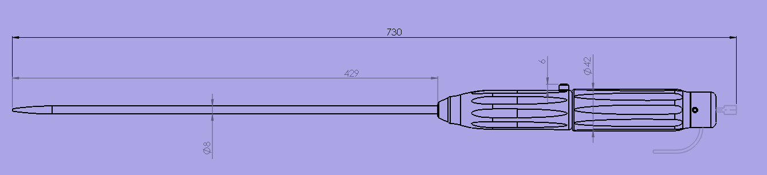
TAVI XPAND™ delivery system
for predictable proven results!
TAVI XPAND™ Delivery System; Article No. 42 505 306 041 55

Slide 16
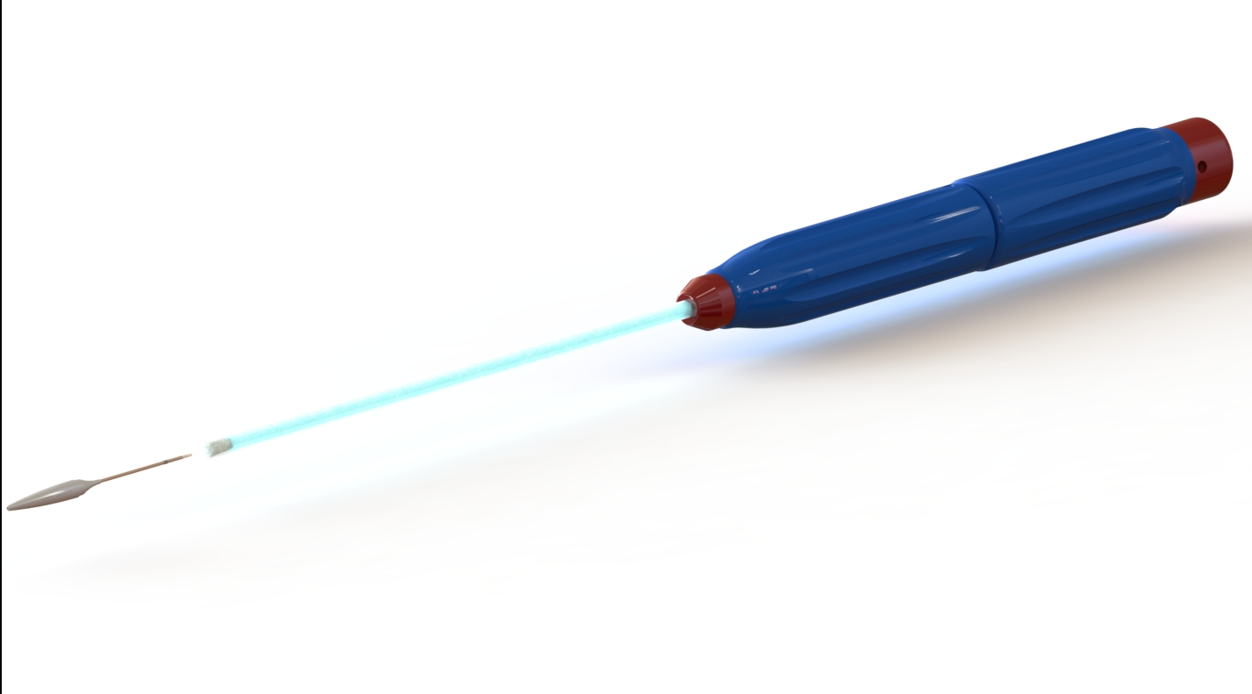
Special Features of TAVI XPAND™ Delivery System
◎
Steady and precise expansion providing 99% accuracy at first attempt
Low delivery profile
Dual articulation for enhanced coaxiality
Optimal positioning control
◎
◎
◎

Slide 17
Thank you!
Any questions?
info@xpandmed.com.ua
+380 63 588 9898
www.xpandmed.com.ua

Slide 18
REFERENCES
A state of the “heart”: application of bioengineered materials for cardiac surgery /A. A. Sokol, D. A. Grekov, G. I. Yemets, A. Y. Galkin, N. V. Shchotkina, A. A. Dovghaliuk, O. V. Telehuzova, I. M. Yemets // Journal of Education, Health and Sports. – 2020. – Vol.10, №9 – P. 927-936.
Comparison of bovine pericardium decellularization protocols for production of biomaterial for cardiac surgery / A. A. Sokol, D. A. Grekov, G. I. Yemets, A. Yu. Galkin, N. V. Shchotkina, A. A. Dovghaliuk, O. V. Telehuzova, I. M. Yemets // Biopolymers and Cell. – 2020. – Vol. 36. № 5. – P. 392-403.
The efficiency of decellularization of bovine pericardium of different concentration of sodium dodecyl sulfate / A.A. Sokol, D.A. Grekov G.I. Yemets, O.Yu. Galkin, N.V. Shchotkina, A. A. Dovghaliuk, N.M. Rudenko, I.M. Yemets // Innovative Biosystems and Bioengineering. – 2020. – Vol.4, № 4. – P. 189 – 198.
Biocompatibility analysis of the decellularized bovine pericardium / A.A. Sokol, D.A. Grekov, G.I. Yemets, O.Yu. Galkin, N.V. Shchotkina, I.M. Yemets // Cell and Organ Transplantology. – 2020. – Vol.8, №2 – P. 112-116.
Prospects for application of bovine pericardial scaffold for cardiac surgery / A.A. Sokol, D.A. Grekov, G.I. Yemets, O.Yu. Shchotkina, A.A. Dovgaliuk, N.M. Rudenko, I.M. Yemets // Biotechnologia Acta. – 2020 – Vol. 13, №6 – P. 41- 49.
**Bovine pericardium vs dacron for patch angioplasty after carotid endarterectomy: a prospective randomized study. Brian J Marien 1, Joseph D Raffetto, Craig S Seidman, Wayne W LaMorte, James O Menzoian.Clinical Trial Arch Surg. 2002 Jul;137(7):785-8. doi: 10.1001/archsurg.137.7.785.
Optimized method of bovine pericardium decellularization for tissue engineering / Nataliia V. Shchotkina, Anatoliy A. Sokol, Oleksandr Yu. Galkin, Glib I.Yemet, Liudmyla V. Dolinchuk, Nadiya M. Rudenko, Iliia M.Yemets //Wiadomości Lekarskie. – 2021 – Vol. LXXIV. ISSUE 4, April 2021;74(4):815-820. DOI:10.36740/WLek202104101.

